Slide 1
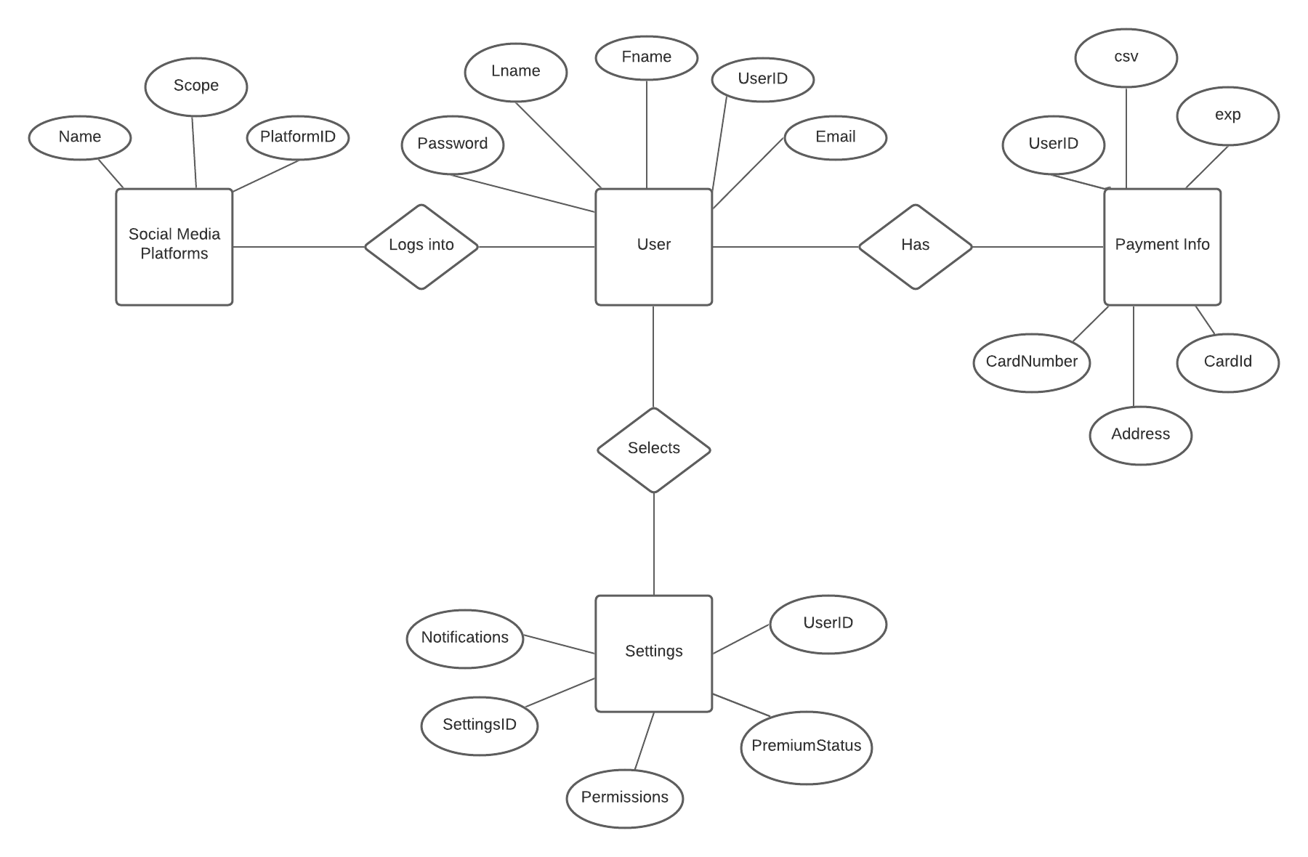
Team 5: Streamfeeder Conceptual ER Diagram

Slide 2
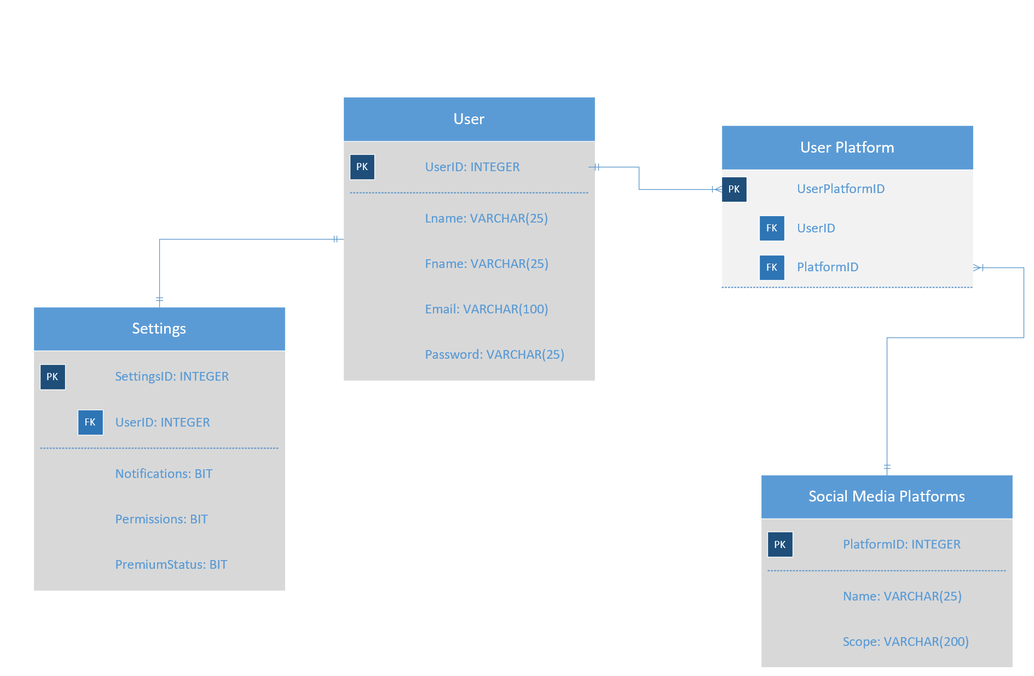
Team 5: Streamfeeder Logical ER Diagram

